Slide 1
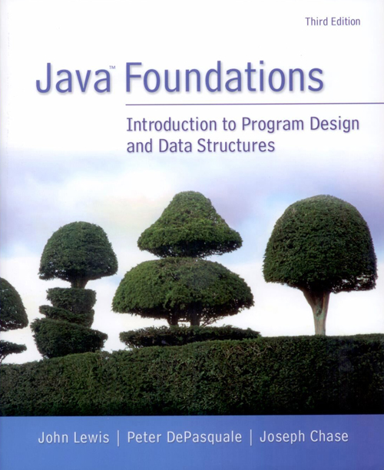
Chapter 1
Introduction

Slide 2
Chapter Scope
Introduce the Java programming language
Program compilation and execution
Problem solving in general
The software development process
Overview of object-oriented principles

Slide 3
Java
A computer is made up of hardware and software
hardware – the physical, tangible pieces that support the computing effort
program – a series of instructions that the hardware executes one after another
Programs are sometimes called applications
software – consists of programs and the data those programs use

Slide 4
Java
A programming language specifies the words and symbols that we can use to write a program
A programming language employs a set of rules that dictate how the words and symbols can be put together to form valid program statements
The Java programming language was created by Sun Microsystems, Inc.
It was introduced in 1995 and its popularity grew quickly

Slide 5
Java
In the Java programming language
a program is made up of one or more classes
a class contains one or more methods
a method contains program statements
These terms will be explored in detail throughout the course
A Java application always contains a method called main

Slide 6
//********************************************************************
// Lincoln.java Java Foundations
//
// Demonstrates the basic structure of a Java application.
//********************************************************************
public class Lincoln
{
//-----------------------------------------------------------------
// Prints a presidential quote.
//-----------------------------------------------------------------
public static void main(String[] args)
{
System.out.println("A quote by Abraham Lincoln:");
System.out.println("Whatever you are, be a good one.");
}
}

Slide 7
A Java Program
public class MyProgram
{
}
class header
class body
Comments can be placed almost anywhere

Slide 8
A Java Program
// comments about the class
public class MyProgram
{
}
// comments about the method
public static void main(String[] args)
{
}
method header
method body

Slide 9
Comments
Comments should be included to explain the purpose of the program and describe processing
They do not affect how a program works
Java comments can take three forms:
// this comment runs to the end of the line
/* this comment runs to the terminating
symbol, even across line breaks */
/** this is a javadoc comment */

Slide 10
Identifiers
Identifiers are the words a programmer uses in a program
can be made up of letters, digits, the underscore character ( _ ), and the dollar sign
cannot begin with a digit
Java is case sensitive
Total, total, and TOTAL are different identifiers
By convention, programmers use different case styles for different types of identifiers, such as
title case for class names - Lincoln
upper case for constants - MAXIMUM

Slide 11
Identifiers
Sometimes we choose identifiers ourselves when writing a program (such as Lincoln)
Sometimes we are using another programmer's code, so we use the identifiers that he or she chose (such as println)
Often we use special identifiers called reserved words that already have a predefined meaning in the language
A reserved word cannot be used in any other way

Slide 12
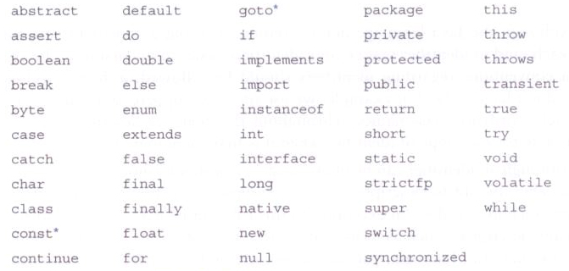
Reserved Words
Java reserved words:

Slide 13
White Space
Spaces, blank lines, and tabs are called white space
White space is used to separate words and symbols in a program
Extra white space is ignored
A valid Java program can be formatted many ways
Programs should be formatted to enhance readability, using consistent indentation

Slide 14
//********************************************************************
// Lincoln2.java Java Foundations
//
// Demonstrates a poorly formatted, though valid, program.
//********************************************************************
public class Lincoln2{public static void main(String[]args){
System.out.println("A quote by Abraham Lincoln:");
System.out.println("Whatever you are, be a good one.");}}

Slide 15
//********************************************************************
// Lincoln3.java Java Foundations
//
// Demonstrates another valid program that is poorly formatted.
//********************************************************************
public class
Lincoln3
{
public
static
void
main
(
String
[]
args )
{
System.out.println (
"A quote by Abraham Lincoln:" )
; System.out.println
(
"Whatever you are, be a good one."
)
;
}
}

Slide 16
Program Development
The mechanics of developing a program include several activities
writing the program in a specific programming language (such as Java)
translating the program into a form that the computer can execute
investigating and fixing various types of errors that can occur
Software tools can be used to help with all parts of this process

Slide 17
Language Levels
There are four programming language levels
machine language
assembly language
high-level language
fourth-generation language
Each type of CPU has its own specific machine language
The other levels were created to make it easier for a human being to read and write programs

Slide 18
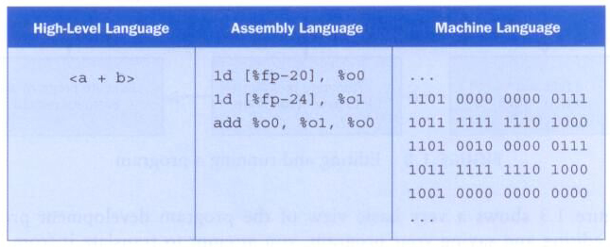
Language Levels
A high-level expression and its lover level equivalents:

Slide 19
Compilation
Each type of CPU executes only a particular machine language
A program must be translated into machine language before it can be executed
A compiler is a software tool which translates source code into a specific target language
Often, that target language is the machine language for a particular CPU type
The Java approach is somewhat different

Slide 20
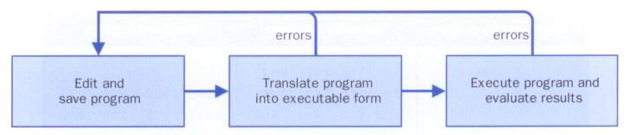
Basic Programming Steps
A program is written in an editor, compiled into an executable form, and then executed
If errors occur during compilation, an executable version is not created

Slide 21
Java Translation
The Java compiler translates Java source code into a special representation called bytecode
Java bytecode is not the machine language for any traditional CPU
Another software tool, called an interpreter, translates bytecode into machine language and executes it
Therefore the Java compiler is not tied to any particular machine
Java is considered to be architecture-neutral

Slide 22
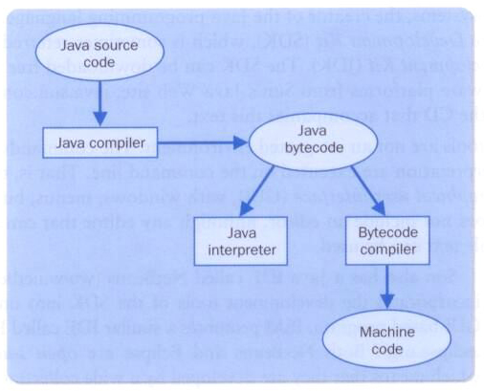
Java Translation

Slide 23
Development Environments
A development environment is the set of tools used to create, test, and modify a program
An integrated development environment (IDE) combine the tools into one software program
All development environments contain key tools, such as a compiler and interpreter
Others include additional tools, such as a debugger, which helps you find errors

Slide 24
Development Environments
There are many environments that support the development of Java software, including:
Sun Java Development Kit (JDK)
Eclipse
NetBeans
BlueJ
jGRASP
Though the details of these environments differ, the basic compilation and execution process is essentially the same

Slide 25
Syntax and Semantics
The syntax rules of a language define how we can put together symbols, reserved words, and identifiers to make a valid program
The semantics of a program statement define what that statement means (its purpose or role in a program)
A program that is syntactically correct is not necessarily logically (semantically) correct
A program will always do what we tell it to do, not what we meant to tell it to do

Slide 26
Errors
A program can have three types of errors:
The compiler will find syntax errors and other basic problems (compile-time errors)
A problem can occur during program execution, such as trying to divide by zero, which causes a program to terminate abnormally (run-time errors)
A program may run, but produce incorrect results, perhaps using an incorrect formula (logical errors)

Slide 27
Problem Solving
The purpose of writing a program is to solve a problem
Solving a problem consists of multiple activities
understand the problem
design a solution
consider alternatives and refine the solution
implement the solution
test the solution
These activities are not purely linear – they overlap and interact

Slide 28
Problem Solving
The key to designing a solution is breaking it down into manageable pieces
When writing software, we design separate pieces that are responsible for certain parts of the solution
An object-oriented approach lends itself to this kind of solution decomposition
We will dissect our solutions into pieces called objects and classes

Slide 29
Development Activities
Any proper software development effort consists of four basic development activities
establishing the requirements
creating a design
implementing the design
testing
These steps also are never purely linear and often overlap and interact

Slide 30
Development Activities
Software requirements specify what a program must accomplish
Requirements are expressed in a document called a functional specification
A software design indicates how a program will accomplish its requirements
Implementation is the process of writing the source code that will solve the problem
Testing is the act of ensuring that a program will solve the intended problem given all of the constraints under which it must perform

Slide 31
Object-Oriented Programming
Java is an object-oriented programming language
As the term implies, an object is a fundamental entity in a Java program
Objects can be used effectively to represent real-world entities
For instance, an object might represent a particular employee in a company
Each employee object handles the processing and data management related to that employee

Slide 32
Objects
An object has
state - descriptive characteristics
behaviors - what it can do (or what can be done to it)
The state of a bank account includes its account number and its current balance
The behaviors associated with a bank account include the ability to make deposits and withdrawals
Note that the behavior of an object might change its state

Slide 33
Classes
An object is defined by a class
A class is the blueprint of an object
The class uses methods to define the behaviors of the object
The class that contains the main method of a Java program represents the entire program
A class represents a concept, and an object represents the embodiment of that concept
Multiple objects can be created from the same class

Slide 34
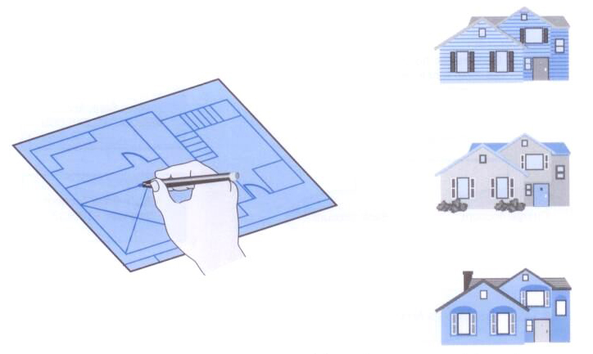
Classes and Objects
A class is like a blueprint from which you can create many of the "same" house with different characteristics

Slide 35
Classes and Objects
An object is encapsulated, protecting the data it manages
One class can be used to derive another via inheritance
Classes can be organized into hierarchies

Slide 36
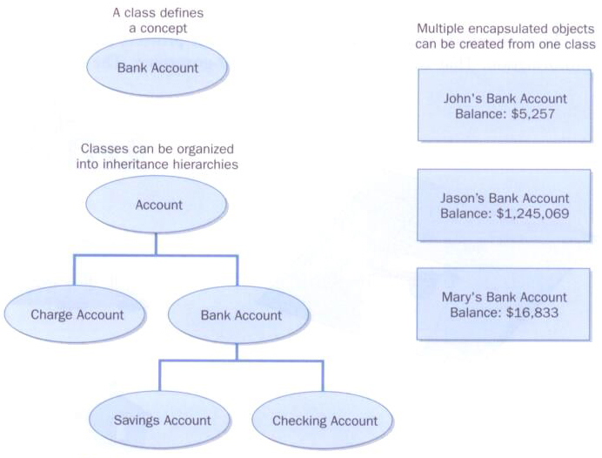
Classes and Objects

